Slide 1
Introduction to C Programming
1

Slide 2
Low-Level Languages
1. Machine languages
Machine language is the low level programming language.
Computers can only understand digital signals, 0 and 1.
For us, difficult to write a code in the form of 0’s and 1’s.
Error-prone
Maintenance is difficult
Not portable, every machine/hardware has its own machine instructions, so programs written for one computer are not valid for other computers.
2

Slide 3
Low-Level Languages
Assembly languages
Machine language now modified to assembly language.
Here, English like words are used to give instructions to the computer.
Example: ADD, SUB, DIV, MOV, LOAD etc.
But computer understands only machine level language.
Need to translate assembly to machine language
The translator that is used for translating is called “ASSEMBLER”
Bit easier
Hardware/machine dependent, due to number of registers
Hence, not portable
3

Slide 4
High-level Languages
3. High-level languages
Codes similar to everyday English
Using mathematical notations
Example:
sum = a + b + c
Designed to ensure high portability.
Easy to write and understand.
But, computer only understands the machine language.
Hence, need of a translator.
“COMPILER” or “INTERPRETER” is used

Slide 5
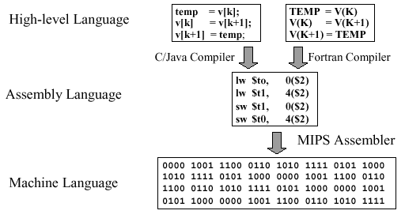
High-level Languages

Slide 6
History of C
Every language has a purpose:
eg: FORTRAN (Formula Translator) – scientific and mathematical applications.
COBOL (Common Business Oriented Language) – used to develop business applications.
One language needed which could be used for multiple purposes.
C language is a structure oriented programming language, was developed at AT&T Bell Laboratories in 1970’s by Dennis Ritchie.
C language was invented for implementing UNIX operating system.
6

Slide 7
History of C
Now, the entire UNIX OS and the tools supplied with it and the C Compiler itself are written in C language.
C language features were derived from earlier language called “B” (Basic Combined Programming Language – BCPL) written by Ken Thompson at AT&T Bell Laboratories.
In 1978, Dennis Ritchie and Brian Kernighan published the first edition “The C Programming Language”.
In 1983, the American National Standards Institute (ANSI) established a committee to provide a modern, comprehensive definition of C. The resulting definition, the ANSI standard, or “ANSI C”.
7

Slide 8
Characteristics of C
C language is not tied to any particular operating system. It can be used to develop new operating systems.
The C language is closely associated with the UNIX operating system. The source code for the UNIX operating system is in C.
The C programs are efficient, fast and highly portable,
i.e. C programs written on one computer can be run on another with mere or almost no modification.
Because C is a hardware-independent.
Suitable for writing both application programs and system programs.

Slide 9
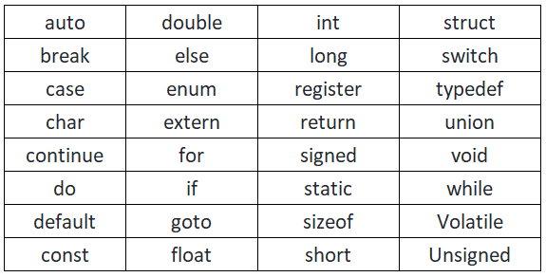
Characteristics of C
C is a small language.
Consists of 32 English words known as “Keywords”
(if, else, for, break, …………………)
Lot of library functions are provided with C, which makes it more powerful.
Also, users can add their own library functions to the library.

Slide 10
Structure of C program
Comments
Preprocessor Directives
Global Variables
int main()
{
local variables
statements
…………..
…………..
return 0;
}

Slide 11
Structure of C program
Comments:
Can be placed anywhere in the program.
Enclosed between delimiters:
Multiple line comments /* */
Single line comments //
Generally used for documentation purpose.
Text surrounded by /* and */ and // is ignored by computer.

Slide 12
Structure of C program
Preprocessor Directives
- These are pre-processed through preprocessor before the C source code passes through the Compiler.
- Commonly used
#include – to include header files
#define – define symbolic constants and macros
Commonly used header files:
#include<stdio.h>
#include<math.h>
#include<stdlib.h>
#include<string.h>
#include<limits.h>

Slide 13
Structure of C program
int main() function
- Every C program must have a main function.
- Execution of every C program starts with main().
- int main() has two parts:
1) Declaration of local variables
2 ) Statements
C programs contain one or more functions, exactly one of which must be main
Parenthesis used to indicate a function ()
int means that main "returns" an integer value
Braces ({ and }) indicate a block
The bodies of all functions must be contained in braces
Statements inside main are executed one by one.

Slide 14
Structure of C program
return 0
- It is written at the end of the int main() function.
- Means that the function has terminated successfully.

Slide 15
Structure of C program
Global Variables & Local variables
Local Variables are declared inside the int main() function, and their scope is local.
Global Variables are declared outside the int main() function and their scope is global.

Slide 16
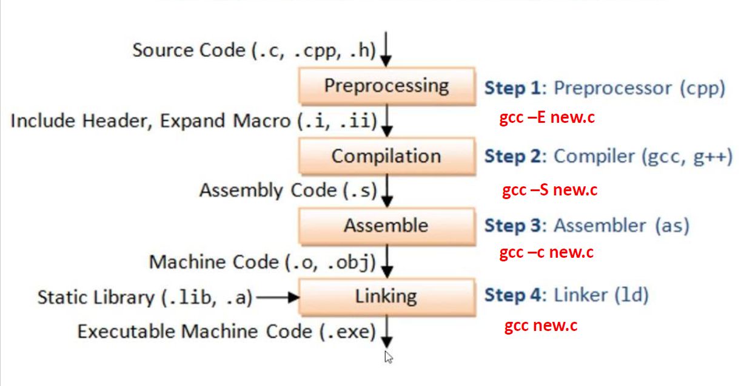

Slide 17
C Programming Standardization
- The C programming language was initially developed at AT & T lab by Professor Brian W. Kernighan and Dennis Ritchie known as K&R C.
- The non-official standard was called K&R C, which lead to many ambiguities among different compiler programmers, and that led to non-portable codes.
- K&R C was the first non-official ‘C’ Standard
- In 1989 American National Standard Institute (ANSI) designed and approved first official C standard called as
X3-159-1989
in 1990 it was approved by ISO as an International standard for C programming language ISO/IEC 9899:1990
- The language underwent few more changes (addition to new fetures, syntax, data types, etc. ) and newly updated standard released in 1999 under the ISO tag ISO/IEC 9899:1999 is also called c99 standard in short.
- C11 is an informal name for ISO/IEC 9899:2011, which is a new standard approved in December 2011.
C11 supersedes the C99 standard.
- Any code written using c90 standard can be compile without any issue with c99 or higher std.
-std=C90
- Any code written using C99 std specific features may not compile successfully in C90 std.
- C23 is the informal name for what will likely become ISO/IEC 9899:2024, the next standard for the C programming language, which will replace C17 (standard ISO/IEC 9899:2018). It was started in 2016 informally as C2x, and expected to be published in 2024.
17

Slide 18
A Simple C Program: Printing a Line of Text
#include<stdio.h>
int main()
{
printf(“Hello World\n”);
return 0;
}
printf
Instructs computer to perform an action
Specifically, prints the string of characters within quotes
(" ")
Entire line called a statement
All statements must end with a semicolon ;
Escape character (\n)
\n is the newline character

Slide 19
Escape Sequence | Name | Description
\n | New Line | It moves the cursor to the start of the next line.
\r | Carriage Return | It moves the cursor to the start of the current line.
\t | Horizontal Tab | It inserts some whitespace to the left of the cursor and moves the cursor accordingly.

Slide 20
1 /
Printing on one line with two printf statements */
#include <stdio.h>
4
/* function main begins
int main( void )
7 {
8
9
10
11 return 0; /* indicate
12
13 } /* end function main */
program execution */
printf statement starts printing from where the last statement ended, so the text is printed on one line.
printf( "Welcome " );
printf( "to PG-DVLSI!\n" );
that program ended successfully */
Welcome to PG-DVLSI!

Slide 21

Newline characters move the cursor to the
1 /*
Printing multiple l
#include <stdio.h>
4
/* function main begins program execution */
int main( void )
7 {
8 printf( "Welcome\nto\nC!\n" );
9
10
11
12 } /* end function main */
ines with a single printf */
next line
return 0; /* indicate that program ended successfully */
Welcome to
C!

Slide 22
C – Data Types
C data types are defined as the data storage format that a variable can store a data to perform a specific operation.
Data types are used to define a variable before its use in a program.
Size of variable, constant and array are determined by data types.

Slide 23
Data Type | Size (bytes) | Range | Format Specifier
short int | 2 | -32,768 to 32,767 | %hd
unsigned short int | 2 | 0 to 65,535 | %hu
unsigned int | 4 | 0 to 4,294,967,295 | %u
int | 4 | -2,147,483,648 to 2,147,483,647 | %d
long int | 8 | -2,147,483,648 to 2,147,483,647 | %ld
unsigned long int | 4 | 0 to 4,294,967,295 | %lu
long long int | 8 | -(2^63) to (2^63)-1 | %lld
unsigned long long int | 8 | 0 to 18,446,744,073,709,551,615 | %llu
signed char | 1 | -128 to 127 | %c
unsigned char | 1 | 0 to 255 | %c
float | 4 | 1.2E-38 to 3.4E+38 | %f
double | 8 | 1.7E-308 to 1.7E+308 | %lf
long double | 12 | 3.4E-4932 to 1.1E+4932 | %Lf

Slide 24
Basic Data Types
int, char, float , double
Integer data type:
Integer data type allows a variable to store numeric values.
“int” keyword is used to refer integer data type.
The storage size of int data type is 4 byte.
int (4 byte) can store values from -2,147,483,648 to
+2,147,483,647.
If you want to use the integer value that crosses the above limit, you can go for “long int” and “long long int” for which the limits are very high.

Slide 25
Integer data type:
We can’t store decimal values using int data type.
If we use int data type to store decimal values, decimal values will be truncated and we will get only whole number.
In this case, float data type can be used to store decimal values in a variable.

Slide 26
Basic Data Types
Character data type:
Character data type allows a variable to store only one character.
Storage size of character data type is 1. We can store only one character using character data type.
“char” keyword is used to refer character data type.
For example, ‘A’ can be stored using char datatype. You can’t store more than one character using char data type.

Slide 27
Basic Data Types
Floating data type (float, double):
1. float:
Float data type allows a variable to store decimal values.
Storage size of float data type is 4 bytes.
We can use up-to 6 digits after decimal using float data type.
For example, 10.456789 can be stored in a variable using float data type.
2. double:
Double data type is also same as float data type which allows up-to 10 digits after decimal.
Storage size of double data type is 8 bytes.

Slide 28
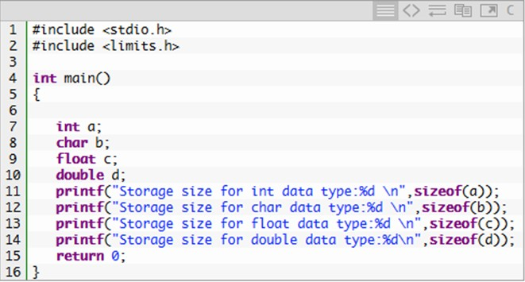
sizeof() function in C
sizeof() function is used to find the memory space allocated for each C data types.

Slide 29
Modifiers/Qualifiers in C
The amount of memory space to be allocated for a variable is derived by modifiers.
Modifiers are prefixed with basic data types to modify (either increase or decrease) the amount of storage space allocated to a variable.
For example, storage space for int data type is 4 byte. We can increase the range by using long int which is 8 byte. We can decrease the range by using short int which is 2 byte.
There are 5 modifiers available in C language. They are,
short
long
signed
unsigned
long long

Slide 30
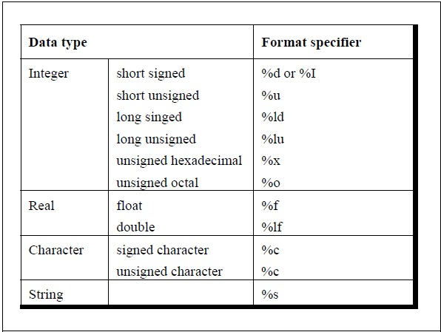
Format specifiers in C

Slide 31
Derived data type in C:
Array, pointer, structure and union are called derived data type in C language.
Void data type in C:
Void is an empty data type that has no value.
This can be used in functions and pointers.

Slide 32
C keywords:
Keywords are pre-defined words in a C compiler.
Each keyword is meant to perform a specific function in a C program.
Since keywords are referred names for compiler, they can’t be used as variable name.
Keywords
auto | double | int | struct
break | else | long | switch
case | enum | register | typedef
char | extern | return | union
const | float | short | unsigned
continue | for | signed | void
default | goto | sizeof | volatile
do | if | static | while

Slide 33
C constants:
C constants are also like normal variables. But, only difference is, their
values cannot be modified by the program once they are defined.
Constants refer to fixed values. They are also called as literals
Constants may be belonging to any of the data type.
Syntax:
const data_type variable_name;
Types of C constant:
Integer constants
Real or Floating point constants
Octal & Hexadecimal constants
Character constants
String constants

Slide 34
Example program using #define directive
#include <stdio.h>
#define height 100
#define number 3.14 #define letter 'A'
#define letter_sequence "ABC"
void main()
{
printf("value of height : %d \n", height ); printf("value of number : %f \n", number ); printf("value of letter : %c \n", letter );
printf("value of letter_sequence : %s \n", letter_sequence);
}

Slide 35
C variable:
C variable is a named location in a memory where a program can manipulate the data. This location is used to hold the value of the variable.
The value of the C variable may get change in the program.
C variable might be belonging to any of the data type like int, float, char etc.
Rules for naming C variable:
Variable name must begin with letter or underscore.
Variables are case sensitive
They can be constructed with digits, letters.
No special symbols are allowed other than underscore.
sum, height, _value are some examples for variable name

Slide 36
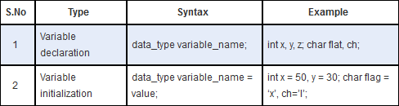
Declaring & initializing C variable:
Variables should be declared in the C program before its use.
Variable initialization means assigning a value to the variable.

Slide 37
Example program using const keyword in C
#include <stdio.h>
int main()
{
const int height = 100; const float number = 3.14; const char letter = 'A';
/*int constant*/
/*Real constant*/
/*char constant*/
const char str[10] = "ABC"; /*string constant*/ */
printf(“value of height : %d \n”, height ); printf(“value of number : %f \n”, number ); printf(“value of letter : %c \n”, letter );
printf(“value of letter_sequence : %s \n”, str);
}

Slide 38
Example program using const keyword in C
#include <stdio.h>
int main()
{
const int a=10;
printf(“value of a : %d \n”, a );
a=a+1;
printf(“value of a : %d \n”, a );
}

Slide 39
C Program: Adding Two Integers
– Comments, #include<stdio.h> and main
int integer1, integer2, sum;
Declaration of variables
Variables: locations in memory where a value can be
stored
int means the variables can hold integers (-1, 3, 0, 47)
Variable names (identifiers)
integer1, integer2, sum
Identifiers: consist of letters, digits (cannot begin with a digit) and underscores( _ )
Case sensitive
Definitions appear before executable statements
If an executable statement references an undeclared
variable it will produce a syntax (compiler) error

Slide 40
1 /*
Addition program */
#include <stdio.h>
4
/* function main begins
int main( void )
7 {
8
9
10
11
program execution */
int integer1; /* first number to be input by user */
int integer2; /* second number to be input by user */
int sum; /* variable in which sum will be stored */
12
13
scanf obtains a value from the user and assigns it to
printf( "Enter first integer\n" ); /* prompt */
scanf( "%d", &integer1 ); /* read an integer */
integer1
14
15
16
17
printf( "Enter second integer\n" ); /* prompt */
scanf( "%d", &integer2 ); /* read an integer */
scanf obtains a value from the user and assigns it to
18
integer2
19
20
sum = integer1 + integer2; /* assign total to sum */
Assigns a value to
sum
printf( "Sum is %d\n", sum ); /* print sum */
21
22 return 0; /* indicate that program ended successfully */
23
24 } /* end function main */
Enter first integer 45
Enter second integer 72
Sum is 117

Slide 41
Assignment Operators
Assignment operators abbreviate assignment expressions
c = c + 3;
can be abbreviated as c += 3; using the addition assignment operator
Statements of the form
variable = variable operator expression;
can be rewritten as
variable operator= expression;
Examples of other assignment operators:
d -= | 4 | (d | = | d | - | 4)
e *= | 5 | (e | = | e | * | 5)
f /= | 3 | (f | = | f | / | 3)
g %= | 9 | (g | = | g | % | 9)

Slide 42
Equality and Relational Operators
Standard algebraic equality operator or relational operator | C equality or relational operator | Example of C condition |  | Meaning of C condition
Equality operators
= | == | x | == y | x is equal to y
≠ | != | x | != y | x is not equal to y
Relational operators
> |  | x | > y | x is greater than y
< | < | x | < y | x is less than y
≥ | >= | x | >= y | x is greater than or equal to y
≤ | <= | x | <= y | x is less than or equal to y

Slide 43
^{Assignment Sample} Explanation Assigns operator expression
Assume: int c = 3, | d | = | 5, e = 4, f | = | 6, g = | 12;
+= | c | += | 7 C | = | c + 7 |  | ???
-= | d | -= | 4 D | = | d - 4 |  | ???
*= | e | *= | 5 E | = | e * 5 |  | ???
/= | f | /= | 3 F | = | f / 3 |  | ???
%= | g | %= | 9 G | = | g % 9 |  | ???
Arithmetic assignment operators.
53

Slide 44
Increment and Decrement Operators
Increment operator (++)
Can be used instead of c+=1
Decrement operator (--)
Can be used instead of c-=1
Pre increment
Operator is used before the variable (++c or --c)
Variable is changed before the expression is evaluated
Post increment
Operator is used after the variable (c++ or c--)
Expression executes before the variable is changed

Slide 45
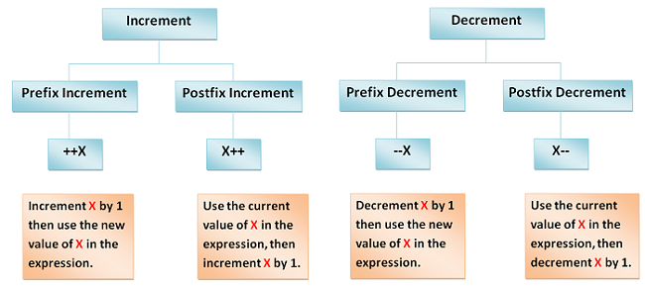
Increment and decrement operators.
56

Slide 46
1 /*
Preincrementing and postincrementing */
#include <stdio.h>
4
/* function main begins program execution */
int main( void )
7 {
8 int c; /* define variable */
9
10
11
12
13
/* demonstrate postincrement */
c = 5;
printf( "%d\n", c );
/* assign 5 to c */
/* print 5 */
14
15
printf( "%d\n", c++ ); /* print 5 then postincrement */
c is printed, then
printf( "%d\n\n", c ); /* print 6 */
incremented
16
17
18
19
/* demonstrate preincrement */
c = 5;
printf( "%d\n", c );
/* assign 5 to c */
/* print 5 */
20
21
printf( "%d\n", ++c ); /* preincrement then print 6 */
c is incremented, then
printf( "%d\n", c ); /* print 6 */
printed
22
23
return 0; /* indicate program ended successfully */
24 } /* end function main */
57

Slide 47
Increment and Decrement Operators
If c equals 5, then
printf( "%d", ++c );
Prints 6
printf( "%d", c++ );
Prints 5
In either case, c now has the value of 6
When variable not in an expression
Pre incrementing and post incrementing have the same effect
++c;
printf( “%d”, c );
Has the same effect as
c++;
printf( “%d”, c );

Slide 48
C Logical Operators
Logical operators in C are used to combine multiple conditions/constraints. Logical Operators returns either 0 or 1, it depends on whether the expression result is true or false.
In C programming for decision-making, we use logical operators.
We have 3 logical operators in the C language:
Logical AND ( && ) - If both operands are non zero then the condition becomes true. Otherwise, the result has a value of 0.
Logical OR ( || ) - The condition becomes true if any one of them is non-zero. Otherwise, it returns false i.e., 0 as the value.
Logical NOT ( ! ) - If the condition is true then the logical NOT operator will make it false and vice-versa.
(operand_1 && operand_2)

Slide 49
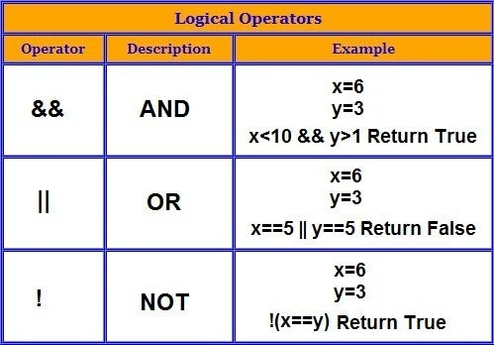

Slide 50
Common Programming Errors
A calculation in an assignment statement must be on the right side of the = operator. It is a syntax error to place a calculation on the left side of an assignment operator.
Forgetting one or both of the double quotes surrounding the
format control string in a printf or scanf.
Forgetting the % in a conversion specification in the format control string of a printf or scanf.
Placing an escape sequence such as \n outside the format
control string of a printf or scanf.
Not providing a conversion specifier when one is needed in a printf format control string to print the value of an expression.

Slide 51
Decision Control Statements
In decision control statements, group of statements are executed when condition is true. If condition is false, then else part statements are executed.
There are 3 types of decision making control statements in C language. They are,
if statements
if else statements
nested if statements

Slide 52
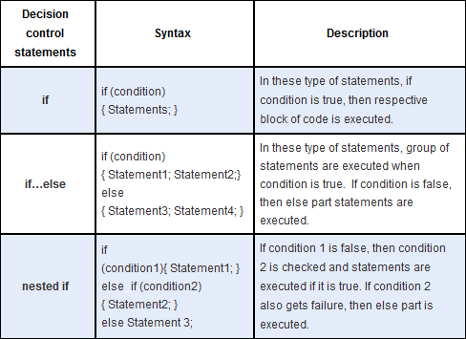
Decision Control Statements

Slide 53
Write a C program to find out biggest of three input numbers.

Slide 54
Loop Control Statements
•
Loop control statements are used to perform looping
operations until the given condition is true. Control comes out of the loop statements once condition becomes false.
Types of loop control statements in C:
There are 3 types of loop control statements in C language. They are,
for
while
do-while

Slide 55
Loop Control Statements
while - It is a form of an entry-controlled loop
Initialization: initialize the loop variable
Conditional Statement: The while loop body will be executed if and only the test condition defined in the conditional statement is true.
Body: set of statements that will be executed till the condition is true
Updating: updates the value of the loop variable

Slide 56
Loop Control Statements
Do-while - It is a form of an exit-controlled loop
do…while loop, the body of the loop is executed first and then the test condition/expression is checked, unlike other loops where the test condition is checked first.
When the test condition is evaluated as true, the program control goes to the start of the loop and the body is executed once more.
The above process repeats till the test condition is true.
When the test condition is evaluated as false, the program controls move on to the next statements after the do…while loop.

Slide 57
Loop Control Statements
For loop
Step 1: Initialization is the basic step of for loop this step occurs only once during the start of the loop. During Initialization, variables are declared, or already existing variables are assigned some value.
Step 2: During the Second Step condition statements are checked and only if the condition is the satisfied loop we can further process otherwise loop is broken.
Step 3: All the statements inside the loop are executed.
Step 4: Updating the values of variables has been done as defined in the loop. Continue to Step 2 till the loop breaks.

Slide 58
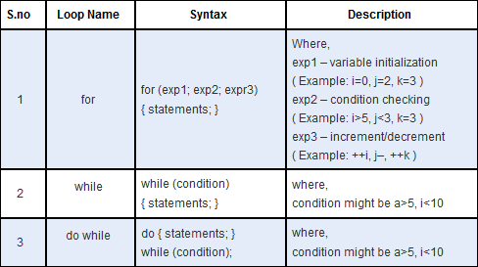
Loop Control Statements

Slide 59
Case Control Statements
The statements which are used to execute only specific block of statements in a series of blocks are called case control statements.
There are 4 types of case control statements in C language. They are,
switch
break
continue
goto

Slide 60
Switch Case Statement
Switch case statements are used to execute only specific case statements based on the switch expression.
Below is the syntax for switch case statement.
switch (expression)
{
case label1:
statements; break; statements; break; statements; break;
case label2:
default:
}

Slide 61
Calculator program using switch
#include <stdio.h> #include <stdlib.h> int main()
{
char operator; float num1,num2;
printf("Enter operator either + or - or * or divide : "); scanf("%c",&operator);
printf("Enter two operands: "); scanf("%f%f",&num1,&num2); switch(operator)
{
case '+‘: printf("num1+num2=%.2f",num1+num2); case '-‘: printf("num1-num2=%.2f",num1-num2); case '*‘: printf("num1*num2=%.2f",num1*num2); case '/‘: printf("num2/num1 = %.2f",num1/num2); default: printf("Error! operator is not correct");
}
return 0;
break; break; break; break;
break;
}

Slide 62
Break and Continue Statement
break statement:
Break statement is used to terminate the while loops, switch case loops and for loops from the subsequent execution.
Syntax: break;
continue statement :
Continue statement is used to continue the next iteration of for loop, while loop and do-while loops. So, the remaining statements are skipped within the loop for that particular iteration.
Syntax : continue;

Slide 63
goto Statement
goto statements is used to transfer the normal flow of a program to the specified label in the program.
Below is the syntax for goto statement in C.
{
…….
goto label;
…….
…….
LABEL:
statements;
}

Slide 64
Functions
Functions can be invoked in two ways: Call by Value or Call by Reference.
Call By Value in C
In call by value method of parameter passing, the values of actual parameters are copied to the function’s formal parameters.
There are two copies of parameters stored in different memory locations.
One is the original copy and the other is the function copy.
Any changes made inside functions are not reflected in the actual parameters of the caller.

Slide 65
Functions
Functions can be invoked in two ways: Call by Value or Call by Reference.
Call by Reference in C
In call by reference method of parameter passing, the address of the actual parameters is passed to the function as the formal parameters. In C, we use pointers to achieve call-by-reference.
Both the actual and formal parameters refer to the same locations.
Any changes made inside the function are actually reflected in the actual parameters of the caller.

Slide 66
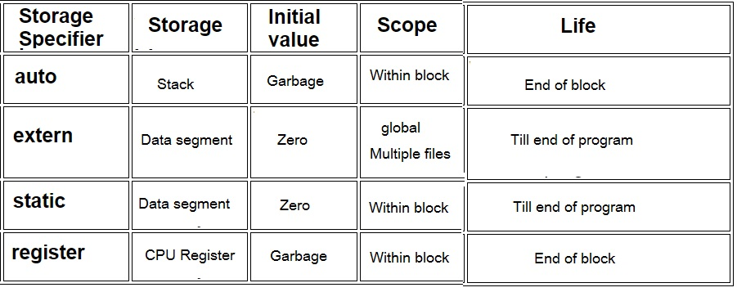
Storage Classes in C

Slide 67
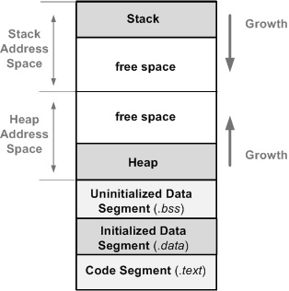
Memory Layout of a C Program

Slide 68
Stack Segment:
The stack is a region of memory used to manage function calls and local variables. It operates as a Last-In-First-Out (LIFO) data structure, meaning the most recently added item is the first to be removed. When a function is called, its local variables and function parameters are allocated on the stack. As functions exit, their allocated stack space is deallocated, making the stack efficient for managing scope-bound data i.e. It grows and shrinks automatically during function calls and returns.
Stack memory is limited, and excessive allocation or deep function call chains can lead to stack overflow, causing the program to crash.

Slide 69
Heap Segment:
Unlike the stack, the heap is a dynamic memory region used for dynamic memory allocation. Memory allocated on the heap must be explicitly managed by the programmer using functions like malloc(), calloc(), realloc() and free(). Heap memory is not deallocated automatically and can persist beyond the scope of a single function.
The heap is essential for handling data structures with dynamic sizes, like arrays whose sizes are determined at runtime or complex data structures like linked lists and trees. Improper heap memory management can lead to memory leaks or fragmentation, where memory becomes inefficiently utilized due to small chunks of allocated but unused memory.

Slide 70
BSS (Block Started by Symbol) Segment:
The BSS segment contains uninitialized global and static variables. These variables are initialized to zero or null values before the program begins execution. Since these variables are not explicitly initialized in the code, the BSS segment reduces the size of the executable, as only the variables and sizes are stored.
Declaring global or static variables without explicit initialization, like int uninitialized Var;, places them in the BSS segment. However, if the variables are initialized, they are stored in the data segment instead.

Slide 71
Data Segment:
The data segment holds initialized global and static variables. These variables have predefined values set during program compilation. Unlike the BSS segment, the data segment consumes space in the executable to store both variables and their initial values.
Global variables, which can be accessed throughout the program, and static variables, which are limited to their defining scope, are stored in the data segment. For example, int globalVar = 42; would result in the storage of globalVar in the data segment.

Slide 72
Text Segment:
The text segment, also known as the code segment, contains the compiled machine code of the program's instructions. This segment is read-only and holds the executable instructions that the CPU fetches and executes during the program's runtime.
Since the text segment is read-only, attempts to modify its contents will result in segmentation faults or program crashes. This segment is responsible for the program's actual functionality and execution flow.

